Slide 1
Facial expression classification Proposal
Libby Blair, Tom Cobham, Ankit Patel

Slide 2
Proposal
Our project will leverage a facial expression dataset to train and test an algorithm capable of accurately identifying positive and negative emotional responses, as well as potential threats.
Through analysis and testing, we will develop an algorithm that meets the objectives of our project and produces results of the highest accuracy.

Slide 3
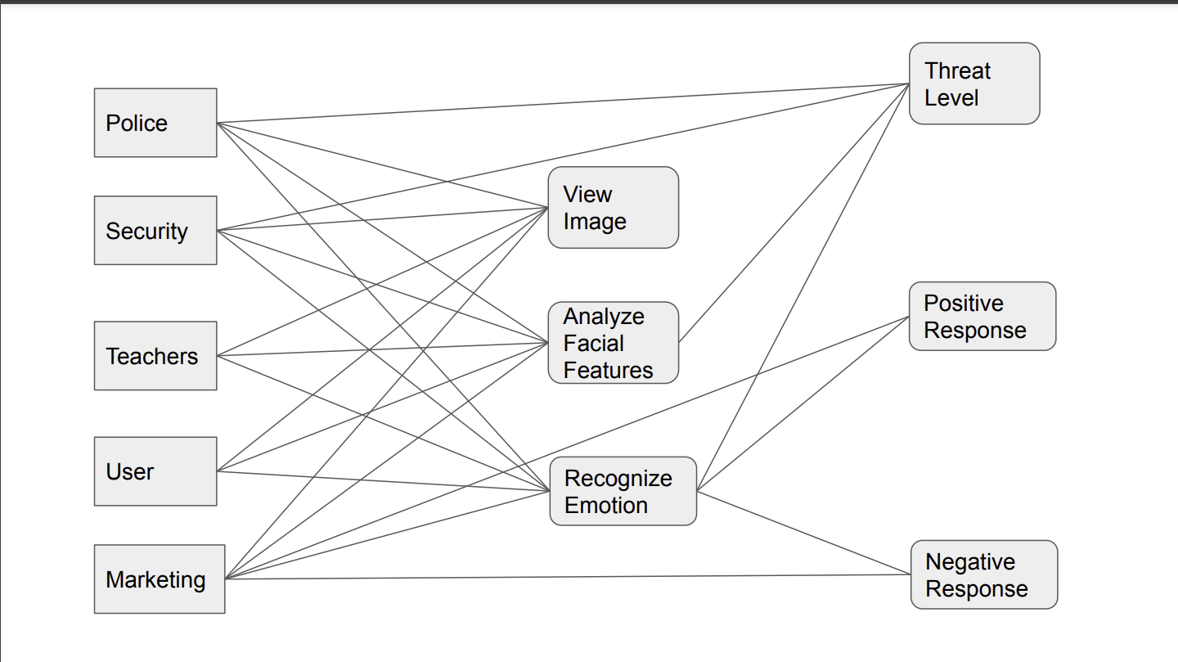
Use-Case Diagram

Slide 4
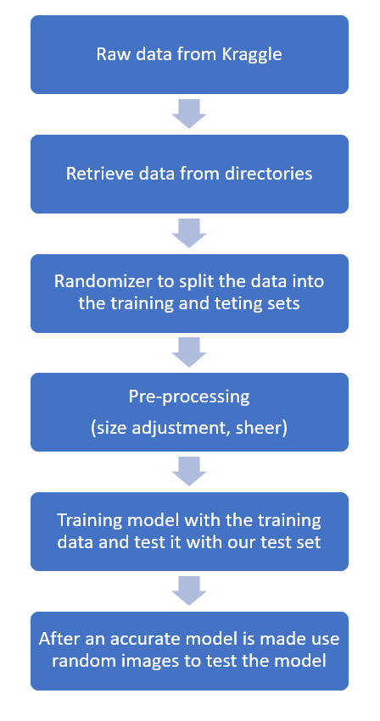
Data Flow Diagram
Our proposed approach involves the adaptation and utilization of the available data to complete our project.

Slide 5
System Design
Our project will implement a sequential model with both max pooling and conv 2D layers to enhance the accuracy of our results.
Diverse activation functions, including Relu and Sigmoid, will be employed to ensure optimal model performance.
Our team will measure the accuracy of our model to quantify its effectiveness.
We will experiment with a variety of optimizers, such as SGD and RMsprop, to identify the most suitable approach for our data.

Slide 6
Member Contribution
Tom: identified a suitable dataset on Kaggle that will be used for our project. He will take responsibility for pre-processing the data.
Also, create code to randomize the images that are run through our model to minimize bias and improve accuracy.
Libby: create presentation slides and perform additional pre-processing tasks.
These tasks include resizing, shearing, and adjusting batch size to ensure uniformity of color (RGB vs. BW) for our input images.
Ankit will develop and implement convolutional neural networks for our project.
He will work on developing a model for training that takes into account the number of epochs and batch size required to optimize our results.
Each member of our team will be responsible for creating a prediction algorithm and testing it to ensure its accuracy and effectiveness.

Slide 7
Methods
The first step in our process will be to retrieve a database of images relevant to our project.
Next, we will pre-process them to ensure optimal performance and eliminate any inconsistencies.
To evaluate the efficacy of our model, we will randomize our images into separate testing and training datasets.
Our team will then create a model tailored to the specific needs of our project.
Once the model is established, we will train and closely monitor the accuracy of our results.
In order to maximize accuracy, we will analyze the data and modify our model accordingly.
Our team will repeat this process until our desired level of accuracy is achieved.

Slide 8
Methods (Part 2)
Our next step will involve the creation of an algorithm capable of accurately predicting emotions from input images.
To verify the accuracy of our algorithm, we will feed it test images and analyze the predicted emotions.
By carefully assessing the accuracy of our predictions, we will ensure that our algorithm performs optimally and meets the objectives of our project.

Slide 9
Dataset from Kaggle
https://www.kaggle.com/datasets/jonathanoheix/face-expression-recognition-dataset
Link for an example code that we will be modeling our algorithms after:
https://www.kaggle.com/code/nakulsingh1289/face-expression-detection-from-scratch

